Slide 1
Digital Marketing Campaign
by Afnan Shaikh

Slide 2


Introduction to Digital Marketing Campaign Conversion Prediction
This project aims to enhance the effectiveness of digital marketing campaigns by accurately predicting customer conversions. By leveraging machine learning, the goal is to identify potential converters and optimize marketing strategies for improved campaign performance.
by Afnan Shaikh

Slide 3







Introduction to Digital Marketing Campaign Conversion Prediction
Project Introduction
Data Gathering and Refinement
Exploratory Data Analysis
Methodology
This section provides an overview of the project, including its objectives and scope.
This section describes the data collection and preprocessing steps undertaken to prepare the data for analysis.
This section outlines the key insights and findings from the exploratory data analysis phase.
This section details the machine learning model selection and training process.
Experimental Results
Conclusion
Appendices and References
This section presents the performance and evaluation of the conversion prediction model.
This section summarizes the key findings and insights from the project.
This section includes additional supporting materials and references.

Slide 4

Introduction
Digital Marketing Campaign Dataset
This dataset provides an in-depth analysis of a digital marketing campaign, focusing on customer interactions, engagement, and conversion metrics. It encompasses various features including customer demographics, campaign details, and response rates. The target variable, 'Campaign Success,' indicates whether a marketing effort led to a successful outcome, offering valuable insights for optimizing future strategies.
The dataset encompasses various key features such as customer demographics, campaign details, engagement metrics, and response rates.
The target variable, 'Campaign Success,' signifies whether the marketing efforts led to a positive outcome.

Slide 5

Project Objectives and Scope
1
Accurate Conversion Prediction
2
Insights for Optimization
Develop a robust machine learning model to predict customer conversions based on demographic and behavioral data.
Uncover valuable insights to help marketers optimize their strategies and improve campaign effectiveness.
3
Scalable Solution
Create a scalable and adaptable system that can be applied across various digital marketing campaigns.

Slide 6
Object of Study and Value of Study
Object of Study
Value of Study
Potential Impact
The primary focus of this project is to analyze customer behavior and demographic data from digital marketing campaigns to predict conversion rates.
By accurately predicting conversions, marketers can optimize their strategies, allocate resources more effectively, and improve overall campaign performance.
Successful implementation of this project can lead to increased return on investment (ROI) and better targeting of potential customers in the digital marketing landscape.

Slide 7

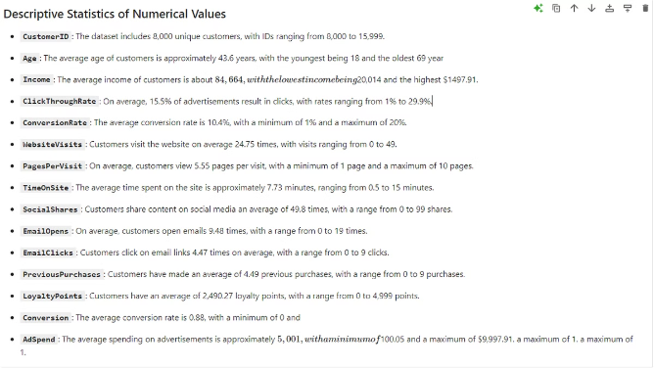
Collecting and Preparing the Data
Comprehensive customer data is the foundation for successful marketing campaigns. This project involves gathering demographic information and behavioral data from various digital channels, including website analytics, email campaigns, and social media interactions.
The dataset includes the following key attributes:
Categorical Columns: Gender, Campaign Channel, Campaign Type, Advertising Platform, Advertising Tool
Numerical Columns: Customer ID, Age, Income, Ad Spend, Click-Through Rate, Conversion Rate, Website Visits, Pages per Visit, Time on Site, Social Shares, Email Opens, Email Clicks, Previous Purchases, Loyalty Points
Target Column: Conversion
After collecting the data, the next step is to preprocess it to ensure quality and consistency. This includes handling missing values, removing outliers, and standardizing data formats. Thorough data cleaning is essential for building accurate predictive models.
The final stage of data preparation involves feature engineering - identifying and extracting the most relevant attributes that will contribute to the model's ability to predict customer conversions. This step requires a deep understanding of the data and the factors that influence marketing campaign success.

Slide 8

EXPLORATORY DATA ANALYSIS
Exploratory Data Analysis (EDA) helped us understand the structure of the dataset, identify patterns, and extract valuable insights that are crucial for optimizing marketing strategies.
During EDA, we analyzed the distribution of each feature, such as customer demographics, engagement metrics, and response rates, and checked the correlations between these features to understand their interrelationships.
Importantly, our dataset was clean and complete, with no missing values or outliers. This provided a solid foundation for the subsequent modeling and analysis stages.

Slide 9
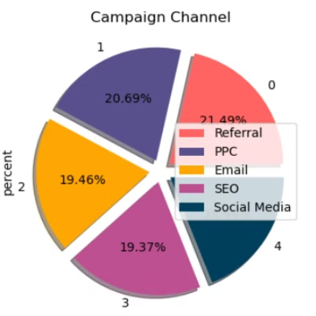
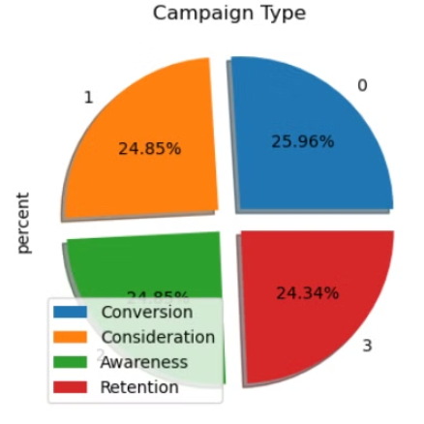
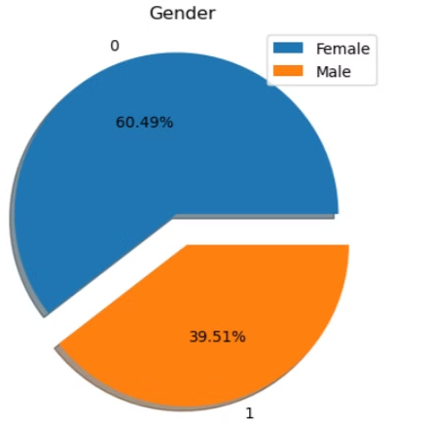
DISTRIBUTION OF CATEGORICAL VARIABLES
Campaign Channel
Campaign Type
Gender
Campaign Channel Distribution:
Campaign Type Distribution:
Gender Distribution:
Referral: Approximately 21.49%
Female: Approximately 60.49%
PPC (Pay-Per-Click): Around 20.69%
Conversion: Approximately 24.85%
Male: Around 39.51%
Consideration: Around 25.96%
Email: About 19.46%
Awareness: About 24.34%
SEO (Search Engine Optimization): Roughly
19.37%
Retention: Also approximately 24.85%
Social Media: Occupies the smallest portion
This chart provides a visual representation of the distribution of marketing campaign channels. It offers insights into the relative popularity and effectiveness of each channel, which can inform marketing strategy decisions.
This chart visually depicts the distribution of different campaign types. It can be used to analyze marketing strategies and resource allocation across various campaign objectives.
This chart visually represents the gender split within the dataset. It shows that females make up the majority, while males constitute the remaining portion.

Slide 10


DISTRIBUTION OF CATEGORICAL VARIABLES
Response Time Distribution:
The graph shows the distribution of response times for website visits.
Most visits fall within a specific range, indicating website performance.
📊
Customer Age Distribution:
Here, we see the age distribution of customers.
The blue bars represent different age groups.
Useful for understanding customer demographics.
📊
Income Distribution:
Income brackets are plotted against the number of individuals.
Helps analyze income levels within a group.
📊
Distribution of Time On Site:
This green bar graph depicts how long visitors stay on a website.
Valuable for assessing user engagement.
📊

Slide 11

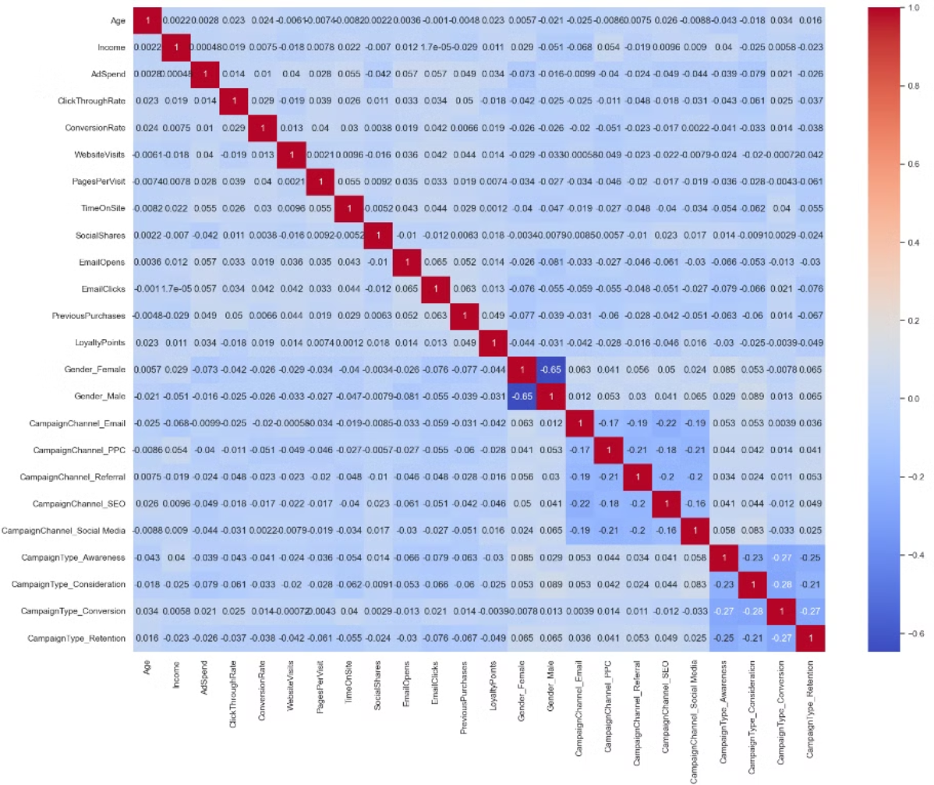
CORRELATION HEATMAP

Slide 12
CORRELATION HEATMAP INSIGHTS
The correlation heatmap reveals several important insights:
Strong Positive Correlations:
EmailOpens and EmailClicks: With a correlation of 0.65, this suggests that users who open emails are very likely to click on the links within those emails.
This indicates a strong relationship between email engagement metrics.
CampaignChannel_PPC and CampaignChannel_SEO: The 0.61 correlation implies that users engaged through PPC campaigns are also likely to be reached effectively
through SEO campaigns. This provides an opportunity to leverage synergies between these marketing channels.
Strong Negative Correlations:
Gender_Female and Gender_Male: The -0.65 correlation is expected, as these are binary and mutually exclusive variables.
CampaignChannel_Referral and CampaignChannel_Email: The -0.48 correlation indicates that users engaged through referral channels are less likely to be responsive to
email campaigns. This underscores the need for tailored marketing strategies for different acquisition channels.
Moderate Correlations:
Income and AdSpend: The 0.48 correlation suggests a moderate positive relationship between higher income and higher ad spend, which provides valuable insights for
targeting and budget allocation.
TimeOnSite and PagesPerVisit: The 0.55 correlation implies that users who spend more time on the site tend to visit more pages, indicating higher engagement levels.
Weak Correlations:
Conversion Rate and most other variables: Conversion Rate shows generally weak correlations with most other variables,
suggesting that conversion rate might be influenced by a complex interaction of several factors rather than any single variable.
.

Slide 13
Preprocessing
The dataset has a significant class imbalance, with 988 instances of class 0 and 7,012 instances of class 1. This imbalance is likely a contributing factor to the poor performance on class 0. To address this, I will employ the SMOTE (Synthetic Minority Over-sampling Technique) method to create synthetic samples of the minority class, effectively balancing the dataset.
There are no missing values in the dataset. I have applied one-hot encoding to the categorical columns like "Gender", "Campaign Type", and "Campaign Channel", as these are nominal variables.
After careful EDA, all features in the dataset appear to be relevant. Therefore, I will retain all columns to ensure no valuable information is lost, especially given the small size of the dataset.

Slide 14

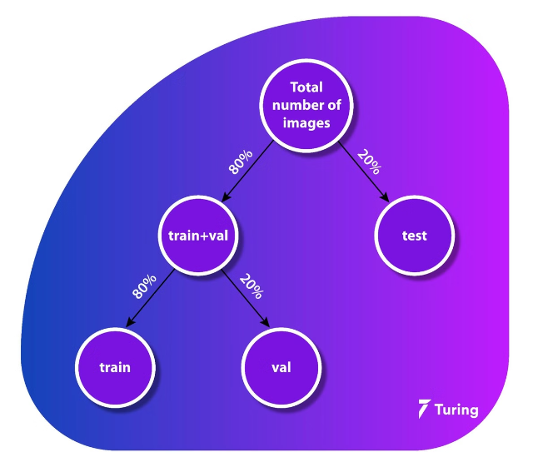
Train-Test Split
To assess the performance of our model, we divided the data into training (80%) and testing (20%) sets. Setting a random state ensures consistent results, and using stratify maintains a proportional distribution of the target variable in both sets.
Splitting X and y
We separated the dataset into two parts: the independent variables, denoted as "X", and the dependent (target) variable we aim to predict, denoted as "y". This split allows us to train our model on X and evaluate its performance on the unseen y values in the test set.

Slide 15




Model Selection and Training
ML Algorithms
Experiment with various machine learning algorithms, such as logistic regression, decision trees, Random Forest, KNN and many more to identify the most suitable model for conversion prediction.
Model Training
Train the selected model using the preprocessed data, optimizing hyperparameters to achieve the best possible performance.
Model Evaluation
Assess the model's performance using appropriate metrics, such as accuracy, precision, recall, and F1-score, to ensure its reliability and effectiveness.

Slide 16
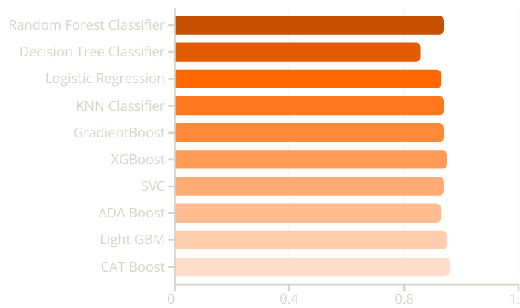
Model Comparasion
Considerations:
Model Selection:
Based on accuracy alone, CAT Boost is the best performing model. However, the choice of model should also consider other factors such as training time, interpretability, and the specific characteristics of the dataset.
Ensemble Methods:
Ensemble methods like CAT Boost, XGBoost, Gradient Boost, and Random Forest are performing exceptionally well, indicating that they handle the data's complexities effectively.
Decision Tree:
The Decision Tree Classifier shows significantly lower accuracy, suggesting it might be overfitting or underfitting. It can be used as a baseline model or further tuned to improve performance.
:
Precision: The accuracy of the model when it claims to have found something.
Recall: Recall: The ability of a model to find all the relevant cases
F1 Score: A balance between recall and precision, useful when both false positives and false negatives need to be minimized.

Slide 17

Conversion Prediction Insights
Customer Segmentation
Influential Factors
Identify key customer segments based on their likelihood to convert, enabling targeted marketing efforts.
Uncover the most significant factors that influence customer conversions, such as demographics, browsing behavior, or campaign channels.
Conversion Trends
Personalized Recommendations
Analyze conversion patterns over time, allowing marketers to adapt strategies based on changing customer preferences and market dynamics.
Provide personalized recommendations to customers based on their predicted conversion likelihood, enhancing the user experience.

Slide 18
Elevating Marketing Effectiveness
Optimize Budget Allocation
Enhance Campaign Targeting
Implement Personalization
Direct your marketing budget towards the most promising customer segments and channels, leveraging conversion prediction insights to maximize impact.
Tailor your content, messaging, and offers to specific customer segments with high predicted conversion rates, ensuring your campaigns resonate and drive results.
Leverage personalized marketing strategies, such as customized recommendations and targeted promotions, to foster deeper customer engagement and boost conversions.

Slide 19

Addressing Challenges and Limitations
1
Ensure Data Quality and Availability
2
Balance Model Complexity and Interpretability
Thorough data collection and validation processes are crucial to building a robust conversion prediction model. Carefully address any gaps, biases, or inconsistencies in the customer data to ensure the model's insights are grounded in reliable information.
Explore more advanced modeling techniques, but also maintain a focus on model interpretability. This will allow you to not only maximize predictive accuracy, but also provide clear, actionable insights that can be easily implemented by the marketing team.
3
Adapt to Evolving Customer Behavior
Continuously monitor changes in customer preferences and market conditions, and refine the model accordingly. Establish a systematic process for retraining and updating the conversion prediction model to ensure it remains relevant and effective over time.

Slide 20

Conclusion and Future Directions
This project has successfully demonstrated the power and potential of machine learning in enhancing marketing strategies and improving campaign performance. By leveraging predictive modeling techniques, marketers can now make more informed, data-driven decisions to optimize their efforts and drive greater success.
To further expand the model's predictive capabilities, we recommend incorporating additional data sources such as social media interactions and real-time market trends. This will enable the model to better adapt to the evolving customer behavior and market dynamics, ensuring that the insights provided remain highly relevant and actionable over time.
Through continuous model refinement and integration of new data sources, the conversion prediction model can become an invaluable tool in the marketer's arsenal, guiding strategic decisions, optimizing budget allocation, and enhancing personalized customer experiences. By embracing this innovative approach, organizations can stay ahead of the curve and maintain a competitive edge in the dynamic digital marketing landscape.

Slide 21

Any Question?
by Afnan Shaikh

Slide 22

Thank You
We sincerely appreciate your time, trust, and support.
by Afnan Shaikh

